Slide 1

Chevening Open Day
2016

Slide 2
History of the Chevening scholarship
Established in 1983 by the Foreign & Commonwealth Office
'Chevening House' is the name of the official country residence of the British Foreign Secretary.
In 1994 Douglas Hurd, then Foreign Secretary, renamed the Foreign & Commonwealth Office's Scholarships and Awards Scheme - 'The British Chevening Scholarships Programme‘
Chevening Programme is funded by the FCO and is administered by the Association of Commonwealth Universities

Slide 3
Priority areas
Legal system reform and the rule of law
Economic, energy and competition reform
Human and minority rights
Public administration reform
Conflict prevention and post-conflict reconciliation

Slide 4
Chevening candidates
Postgraduate students and young professionals
Chevening is for MA only (not PhD or undergraduate)
Academic excellence and leadership potential
A proven track record of success in their chosen field (at least two years of relevant work experience in Serbia)
English language test (Academic IELTS, Pearson PTE Academic, TOEFL iBT, Cambridge English: Advanced (CEA), Trinity ISE II (B2))

Slide 5
Which costs are covered by Chevening?
university tuition fees (for MBA £18,000 cap)
a monthly stipend
travel costs to and from the UK
an arrival allowance
a homeward departure allowance
the cost of one visa application
a travel grant to attend Chevening events in the UK

Slide 6
Essential for application:
Two references to be provided in a letter format and written in English
Valid passport/national ID card
University transcripts (undergraduate, postgraduate)
Three different UK Master's course choices
* Please note that only documents in PDF format can be uploaded and documents cannot be over 5MB in size.
Optional:
English language (if already met the requirements)
UK Master's university offer (if already met the requirements)

Slide 7
Where to apply
http://www.chevening.org/apply

Slide 8
Tips
Remember your username and password
Save as you go!
You do not have to complete the form in one session
You can preview all sections of the application form
Check the size and format of the files you intend to upload (up to 5MB)
Application questions have word counts
Consider preparing your answers offline
Do not plagiarise
Please apply in English
Don't use your browser's 'back' and 'forward' buttons
Don't submit your application unless you are completely satisfied with it

Slide 9
Application
Select your country from the drop down menu below
Select the Chevening Award you wish to apply for (only the award categories open in your country will appear)
Answer the pre-screen questions to see if you’re eligible for a Chevening Award
Create an account
Complete each section of the online application form

Slide 10
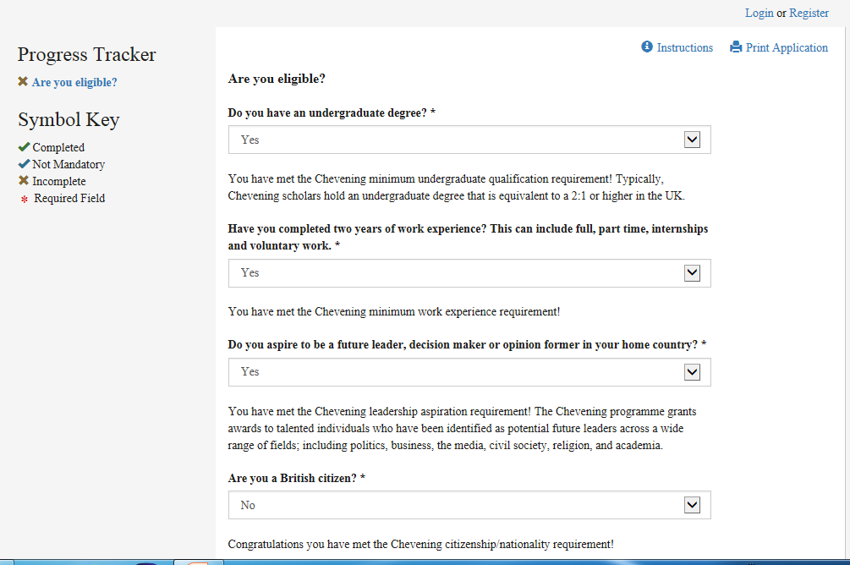

Slide 11
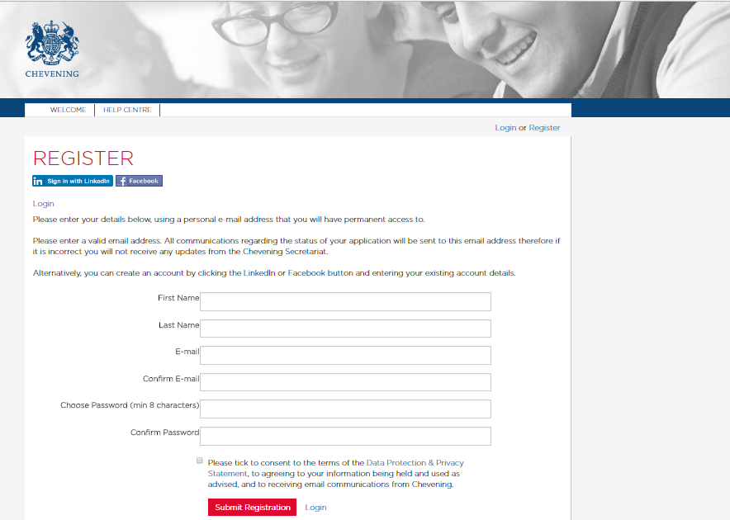

Slide 12
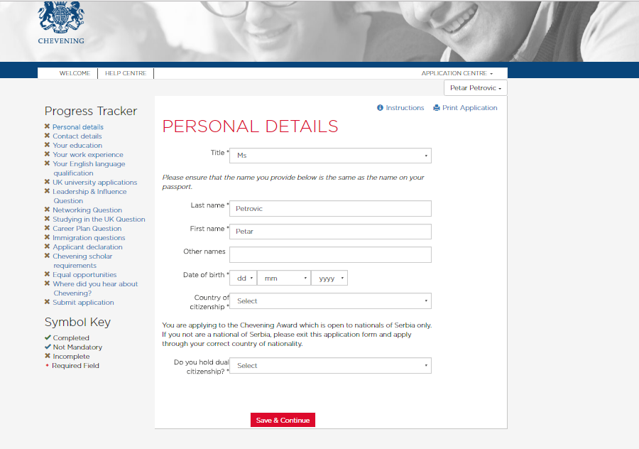

Slide 13


Thank you!
http://chevening.org/contact-us
@UKinSerbia #CheveningSRB
Chevening.Scholarship

